Slide 1

Healthy Living: Everyday Choices
Fuel your body with whole foods.
Move daily to strengthen heart and muscles.
Sleep enough to restore mind, energy.
Manage stress with calming daily routines.
Prevent illness through checkups and hygiene.
Healthy choices add up, day by day.
Notes:
This opening slide frames health as a set of daily, manageable choices rather than a single big decision. The goal is to build habits that support energy, mood, and long-term wellbeing. Whole foods, movement, and sleep form a practical foundation you can start improving immediately. Stress management and social support help keep those habits sustainable when life gets busy. Finally, prevention—through hygiene, vaccines, and regular checkups—reduces avoidable illness and helps you catch problems early. Use the rest of the deck as a simple checklist you can revisit weekly. [Sources] - https://upload.wikimedia.org/wikipedia/commons/3/37/STETHOSCOPE.jpg - https://www.cdc.gov/chronic-disease/prevention/preventive-care.html - https://www.cdc.gov/clean-hands/about/index.html

Slide 2

Nutrition: Build a Balanced Plate
Fill half your plate with vegetables.
Choose whole grains over refined options.
Include lean proteins for lasting fullness.
Prefer healthy fats from nuts, fish.
Drink water often; limit sugary drinks.
Colorful meals support variety and balance.
Notes:
A balanced plate is about variety, not perfection, so aim to include multiple food groups most meals. MyPlate suggests making half your plate fruits and vegetables and choosing whole grains often to increase fiber and micronutrients. Pair carbohydrates with protein to improve satiety and support muscle repair. When choosing fats, prioritize unsaturated sources like plant oils, nuts, seeds, and fish over saturated fats. Hydration matters too—water is a great default beverage, while sugary drinks add calories with few nutrients. Small, repeatable swaps tend to stick better than strict rules. [Sources] - https://upload.wikimedia.org/wikipedia/commons/3/3a/Bowl_of_vegetable_salad_001.jpg - https://myplate-prod.azureedge.us/sites/default/files/2022-01/SSwMP%20Mini-Poster_English_Final2022_0.pdf - https://www.myplate.gov/eat-healthy/what-is-myplate - https://www.heart.org/en/healthy-living/healthy-eating/eat-smart/fats

Slide 3

Physical Activity: Keep Your Body Moving
Aim for 150 minutes weekly moderate activity.
Mix cardio, strength, and flexibility training.
Break up sitting with short movement breaks.
Start small; increase intensity gradually, safely.
Choose activities you enjoy to stay consistent.
Movement can be social and fun.
Notes:
Regular movement supports heart health, mood, sleep, and metabolic health, and it does not need to be complicated. Global and U.S. guidelines recommend at least 150 minutes per week of moderate-intensity activity for most adults. Strength training twice weekly helps maintain muscle and bone, while flexibility and balance work can reduce injury risk. If you sit a lot, quick movement breaks can meaningfully increase your total daily activity. The best plan is the one you can repeat, so choose activities you like and build up gradually to avoid burnout or injury. If you have medical conditions or pain, consider checking with a clinician for personalized guidance. [Sources] - https://upload.wikimedia.org/wikipedia/commons/e/e5/Jogging_couple.jpg - https://www.who.int/initiatives/behealthy/physical-activity - https://www.cdc.gov/physical-activity-basics/guidelines/adults.html

Slide 4

Mental Health: Care for Your Mind
Practice mindfulness to reduce daily stress.
Connect with friends and supportive communities.
Set boundaries to protect time and energy.
Seek help early when feelings overwhelm.
Limit screens and news when anxious.
Mindfulness can train attention and calm.
Notes:
Mental health is health, and small practices can make a real difference in how you feel day to day. Mindfulness meditation is widely used to help reduce stress and can improve well-being for many people. Social connection is protective, so prioritize relationships and communities that support you. Boundaries—like protected downtime and device-free moments—help prevent stress from expanding into every hour. If symptoms are persistent, intense, or interfering with your life, early support from a qualified professional can be highly effective. Treat this slide as permission to take your mind’s needs seriously, just like physical needs. [Sources] - https://upload.wikimedia.org/wikipedia/commons/d/d1/Meditation_%286225530793%29.jpg - https://www.apa.org/topics/mindfulness/meditation - https://www.nccih.nih.gov/health/meditation-and-mindfulness-effectiveness-and-safety

Slide 5

Sleep: Your Body’s Repair System
Keep a consistent bedtime and wake time.
Create a dark, cool, quiet bedroom.
Avoid caffeine and heavy meals late.
Unwind with reading, stretching, or breathing.
Get morning light to set body clock.
Sleep is a cornerstone habit.
Notes:
Sleep supports memory, immune function, mood regulation, and physical recovery, so it is worth protecting. Many adults do best with roughly 7–9 hours of sleep, but quality and consistency matter as much as the number. A regular sleep and wake schedule trains your body to feel sleepy at the right time and alert in the morning. Practical sleep hygiene includes a cool, dark bedroom, limiting caffeine late in the day, and avoiding heavy meals close to bedtime. Light is a key cue for circadian rhythms, so morning light exposure can help anchor your internal clock. If you have loud snoring, persistent insomnia, or daytime sleepiness, consider discussing it with a healthcare professional. [Sources] - https://upload.wikimedia.org/wikipedia/commons/thumb/2/20/The_Sleeping_Girls_in_Japanese_Bed_%283109911667%29_%28cropped%29.jpg/640px-The_Sleeping_Girls_in_Japanese_Bed_%283109911667%29_%28cropped%29.jpg - https://www.thensf.org/how-many-hours-of-sleep-do-you-really-need/ - https://www.health.harvard.edu/staying-healthy/sleep-hygiene-simple-practices-for-better-rest - https://www.nigms.nih.gov/education/fact-sheets/Pages/circadian-rhythms

Slide 6
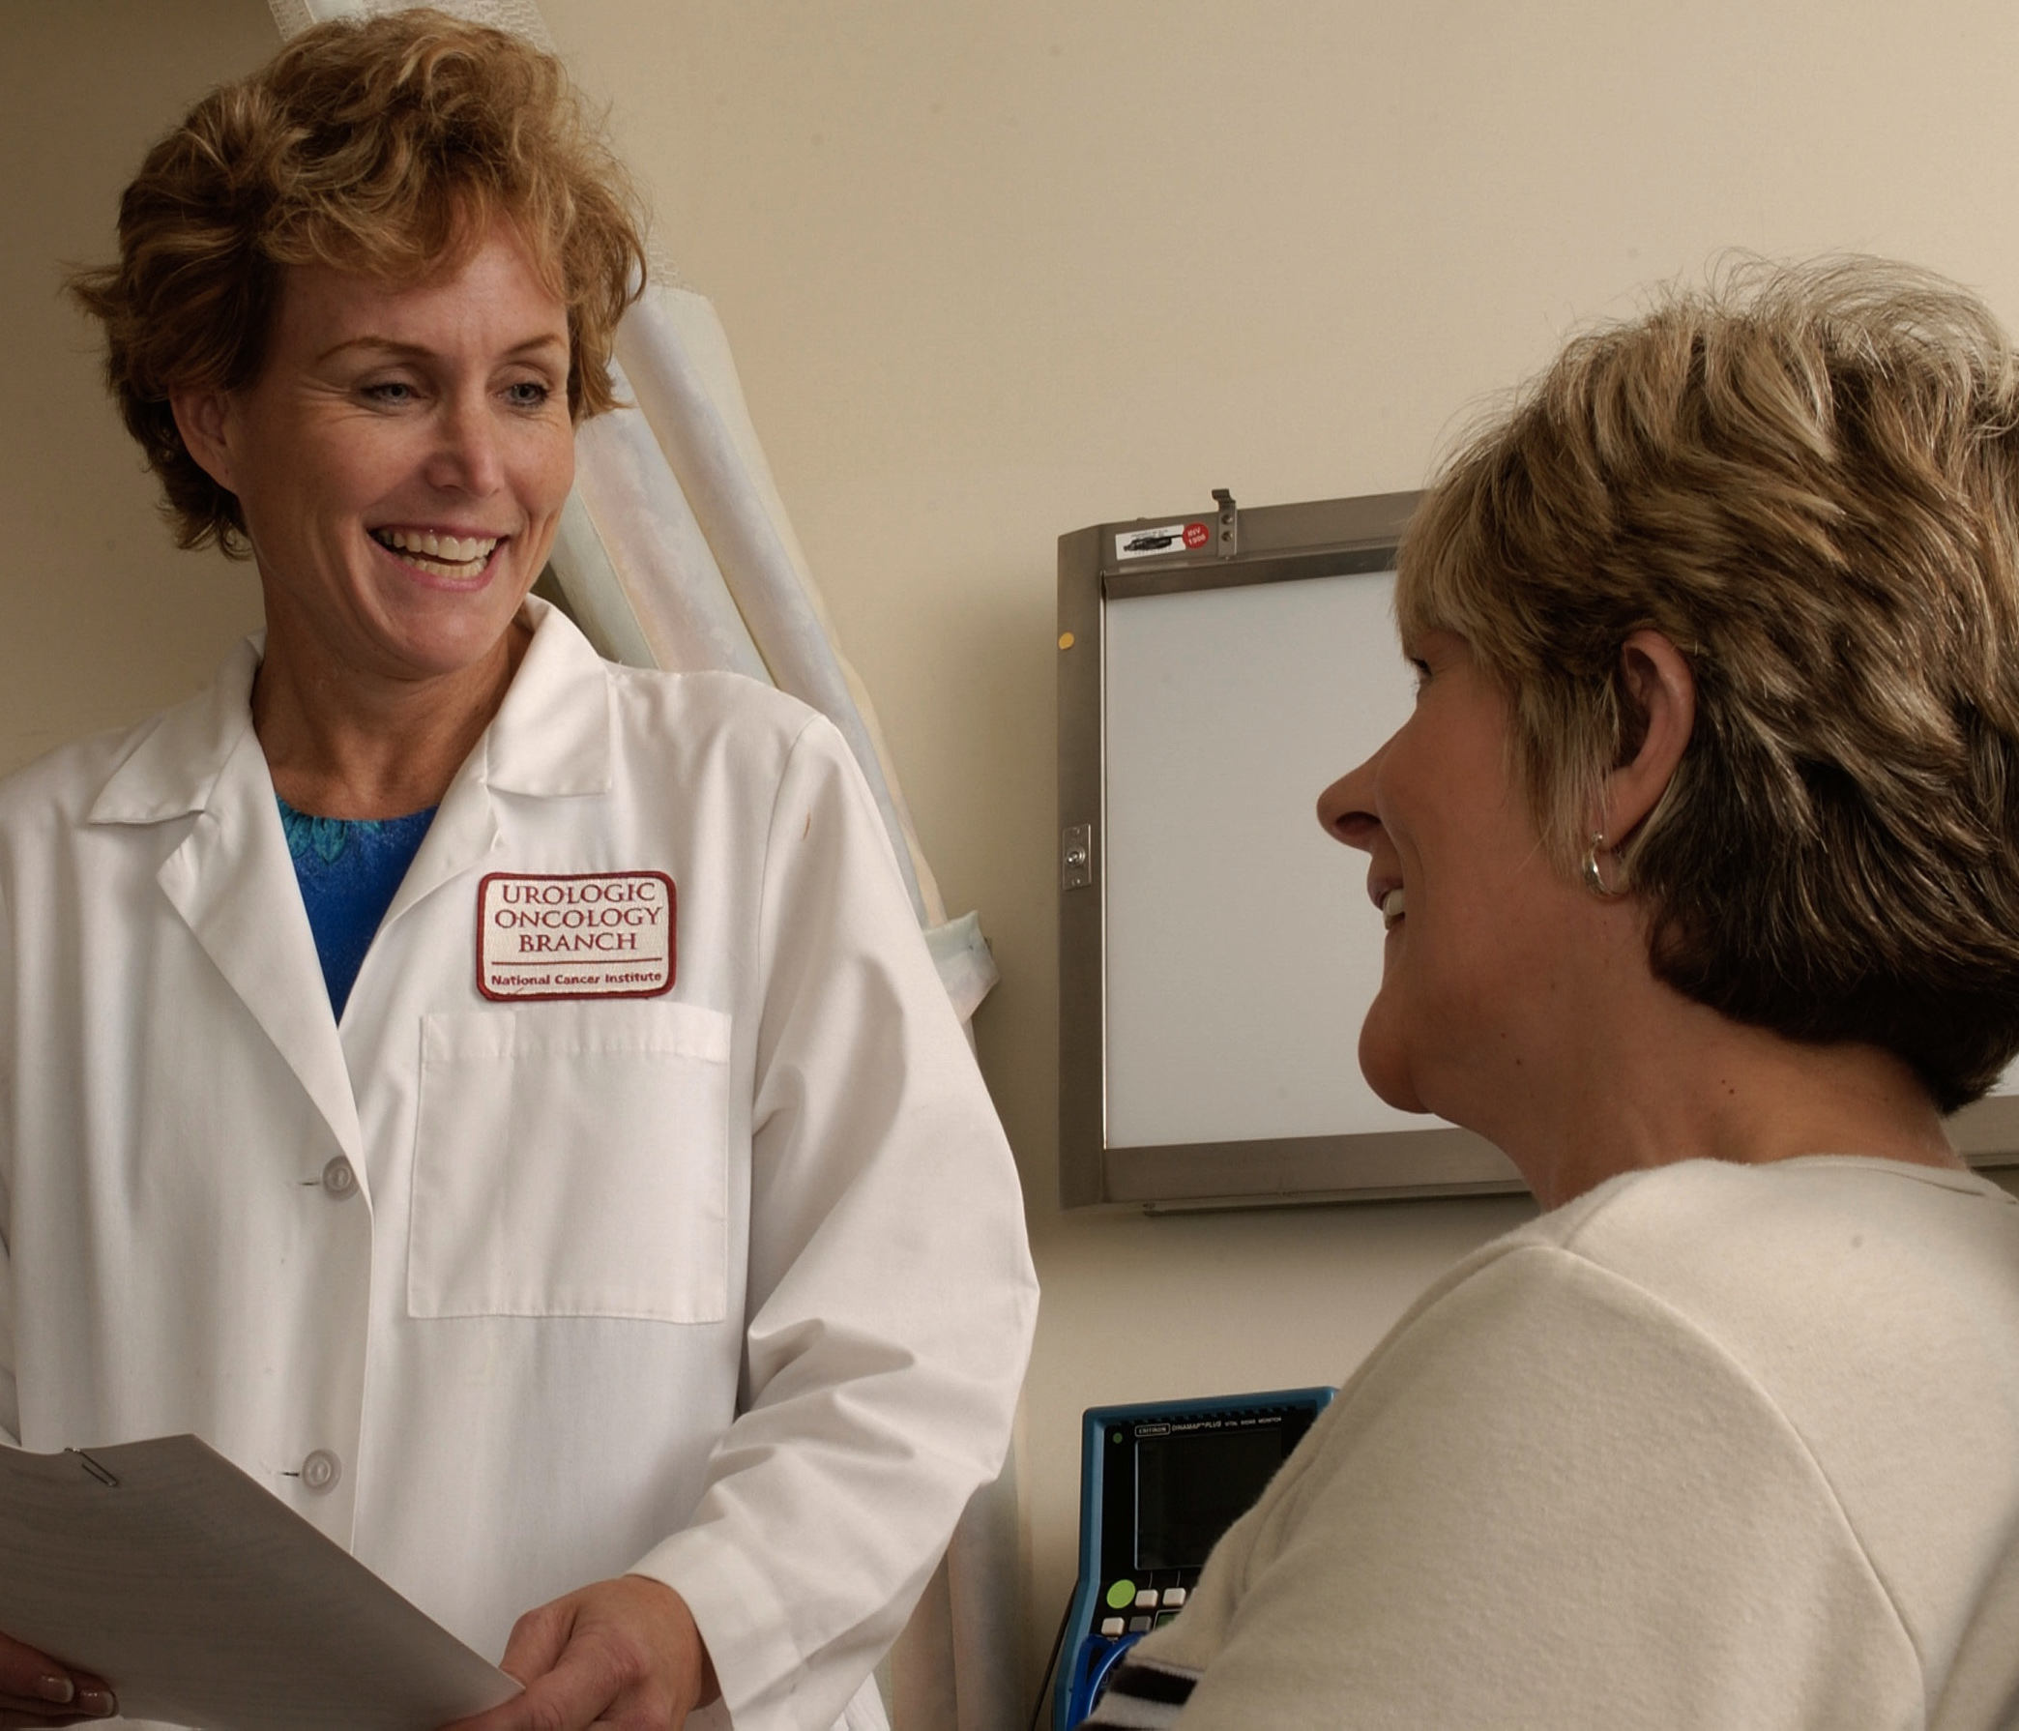
Preventive Care: Stay Ahead of Disease
Schedule routine checkups even when healthy.
Keep vaccinations up to date always.
Know your numbers: blood pressure, glucose.
Screen early for cancers and chronic illness.
Follow medical advice and take medicines correctly.
Prevention helps catch issues early.
Notes:
Preventive care is about reducing risk and spotting problems early, before they become harder to treat. Regular checkups often include screening tests and counseling tailored to your age, history, and risk factors. Vaccines are a key preventive service and recommendations vary, so staying up to date with your clinician helps ensure appropriate protection. Knowing your core health numbers—like blood pressure, blood sugar, and cholesterol—gives you early warning signals and a way to track improvement. The U.S. Preventive Services Task Force publishes evidence-based recommendations for many common screenings. If you’re prescribed medication, taking it as directed is one of the most effective ways to get the intended benefit and avoid complications. [Sources] - https://upload.wikimedia.org/wikipedia/commons/0/0c/Doctor_talking_with_a_patient.jpg - https://www.cdc.gov/chronic-disease/prevention/preventive-care.html - https://www.cdc.gov/vaccines/imz-schedules/adult-easyread.html - https://www.uspreventiveservicestaskforce.org/uspstf/recommendation-topics/uspstf-and-b-recommendations

Slide 7
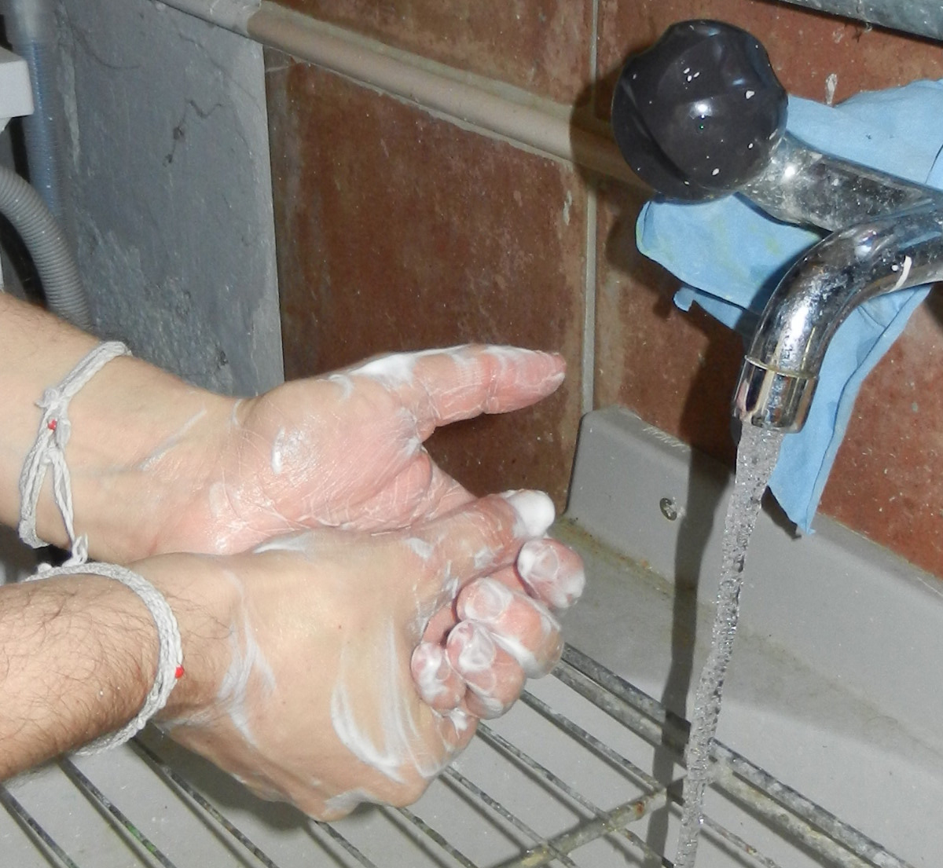
Hygiene: Stop Germs Before They Spread
Wash hands with soap for 20 seconds.
Cover coughs and sneezes with elbow.
Clean high-touch surfaces in shared spaces.
Stay home when sick to protect others.
Use safe water and handle food carefully.
Handwashing is simple and powerful.
Notes:
Hygiene is one of the easiest, highest-impact ways to prevent infections in homes, schools, and workplaces. The CDC recommends scrubbing hands with soap for at least 20 seconds to remove germs effectively. Respiratory etiquette—like coughing into your elbow—reduces droplet spread and protects people around you. Regularly cleaning high-touch surfaces can help reduce transmission, especially in shared environments. When you are sick, staying home when possible is an act of care for others and can prevent outbreaks. Food and water safety also matter, so use clean water and follow basic food-handling practices to avoid gastrointestinal illness. [Sources] - https://upload.wikimedia.org/wikipedia/commons/9/9d/Washing_hands_with_soap_%284%29.jpg - https://www.cdc.gov/clean-hands/about/index.html - https://www.cdc.gov/clean-hands/data-research/facts-stats/index.html

Slide 8

Healthy Habits: Make It Stick
Set one small goal each week.
Track progress and celebrate tiny wins.
Plan meals and workouts on your calendar.
Build supportive environments at home, work.
Be patient; consistency beats perfection long-term.
Systems beat motivation on hard days.
Notes:
Sustainable health change usually happens through small steps repeated consistently, not through short bursts of willpower. Goal-setting and problem-solving skills can help people integrate healthy behaviors into daily routines. Tracking progress—even in a simple notebook—can improve follow-through because it keeps goals visible and actionable. Planning ahead reduces decision fatigue, so scheduling meals and movement is often more effective than relying on “free time.” Environment design matters: keep healthy options convenient and reduce friction for the behaviors you want. Above all, expect progress to be uneven and focus on returning to the habit after disruptions. [Sources] - https://upload.wikimedia.org/wikipedia/commons/thumb/0/03/Checklist_Noun_project_5166.svg/1280px-Checklist_Noun_project_5166.svg.png - https://www.cdc.gov/physical-activity/php/strategies/individual-supports.html - https://www.apa.org/news/press/releases/2015/10/progress-goals - https://www.niddk.nih.gov/health-information/diet-nutrition/changing-habits-better-health

